Slide 1

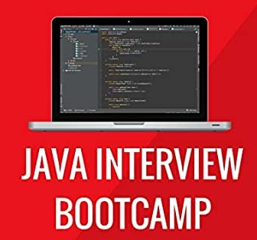
JAVA INTERVIEW BOOTCAMP
Lecture 3

Slide 2

Today’s Agenda
JDK,JRE,JVm and JIT
Popular Interview Questions

Slide 3
JDK V/s JRE V/s JVM V/s JIT
Understanding the difference between JDK,JRE ,JVM and JITC is very very important in Java for interviews
JDK: Java Development kit
JRE: Java Runtime Environment
JVM: Java Virtual Machine
JITC: Just In Time Compiler

Slide 4
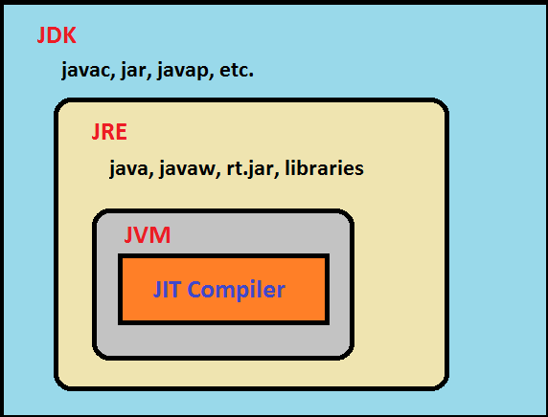
JDK V/s JRE V/s JVM V/s JIT

Slide 5
What Is JVM ?
JVM is the heart of Java programming language, which is responsible for converting Byte code to the machine specific code.
JVM provides core functionality like memory management, garbage collection, security etc.
JVM is customizable and we can use java options to customize it, for example allocating minimum and maximum memory to JVM.
java –Xms256m –Xmx4096m Test
It is designed for each platform(OS+CPU) supported by Java and this means that every platform will have a different version of JVM

Slide 6
What Is Inside JVM ?
Apart from garbage collector and other important tools , the JVM contains 2 translators:
Interpreter
JITC (Just In Time Compiler)

Slide 7
Interpreter V/s JITC
Originally Java only had an interpreter which simply converted bytecode to machine language and sends it for execution to the computer.
But we like any other interpreter , the Java Interpreter converts one line of bytecode to machine language and sends it for execution to the computer.
Then it repeats the same process for line 2

Slide 8
Is There A Problem In This Approach ?
Yes
If an instruction needs to be executed 100 times (for example inside a loop) then the interpreter needs to convert it 100 times.
For example
a=10,i=1;
loop(i<=100)
{
print a;
i++;
}
a=10;
print a;
In the second example the interpreter will have to convert the
statement print a; 100 times since it is running inside a loop

Slide 9
What Is The Solution ?
To solve this problem the developers at SUN came up with a new idea.
They thought if a statement has to be executed multiple times then why not save the converted code in computer’s memory and then next time just execute it without converting it.
That is in the previous code , the statement print a; which is inside the loop would be converted only once and saved in computer’s memory and remaining 99 times it is just executed !.
This is called JITC(Just In Time Compiler) and the statements which have to be executed multiple times are called HotSpots and thus Java’s JVM is also called HotSpot JVM

Slide 10
Popular Interview Question
Are the Java compiler and JITC same?
Answer:
No , not at all.
The java compiler converts source code to bytecode and is not a part of JVM , rather it comes with JDK.
The JITC lives inside the JVM and converts bytecode to machine understandable form

Slide 11
What Is JRE ?
JRE is an acronym for Java Runtime Environment.
It provides a platform to execute Java programs.
It contains a JVM along with java classes/packages ,set of runtime libraries and java application launchers called java.exe and javaw.exe
To execute any Java application, we need JRE installed in the machine. It’s the minimum requirement to execute a Java application on any machine.

Slide 12
Popular Interview Question
Do you know the difference between java.exe and javaw.exe?
Answer:
Both are java application launchers
The only difference is that with java.exe we have a console executed and we need to wait until our java program finishes to run any other command.
On the other hand in case of javaw.exe no console is associated with execution..

Slide 13
What Is JDK ?
JDK stands for Java Development Kit and is a bundle of software that we can use to develop Java based applications.
It includes the JRE, set of library classes, Java compiler , jar and additional files needed to write a Java application.

Slide 14
Popular Interview Question
Can I compile a Java application if I have a JRE ?
Yes
No
Answer:
No , JRE can only be used to run a Java application . It doesn’t contain the javac tool which is used for compilation

Slide 15
Popular Interview Question
Which component is used to compile, debug and execute java program?
A. JVM
B. JDK
C. JIT
D. JRE
Correct Answer:
B

Slide 16
Popular Interview Question
Which component is used to optimize our Java code ?
A. JVM
B. JDK
C. JIT
D. JRE
Correct Answer:
C

Slide 17
Popular Interview Question
Which component is used to convert bytecode to machine specific code ?
A. JVM
B. JDK
C. JIT
D. JRE
Correct Answer:
A

Slide 18
Popular Interview Question
Which component saves the converted machine specific code in computer’s memory if required?
A. JVM
B. JDK
C. JIT
D. JRE
Correct Answer:
C

Slide 19
Popular Interview Question
Which component is used to provide a platform to run a Java program ?
A. JVM
B. JDK
C. JIT
D. JRE
Correct Answer:
D

